Slide 1
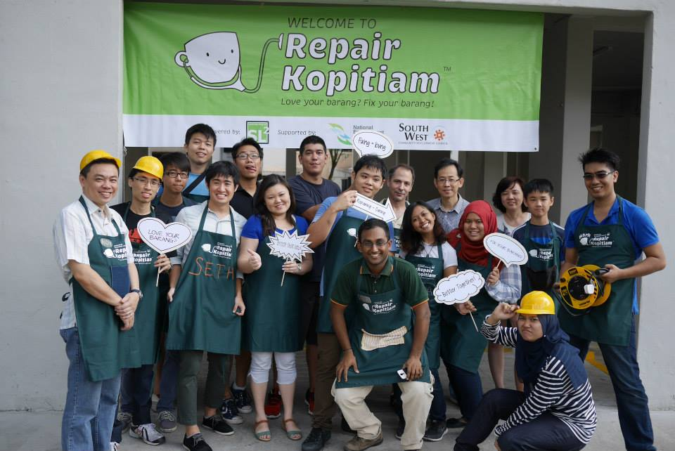
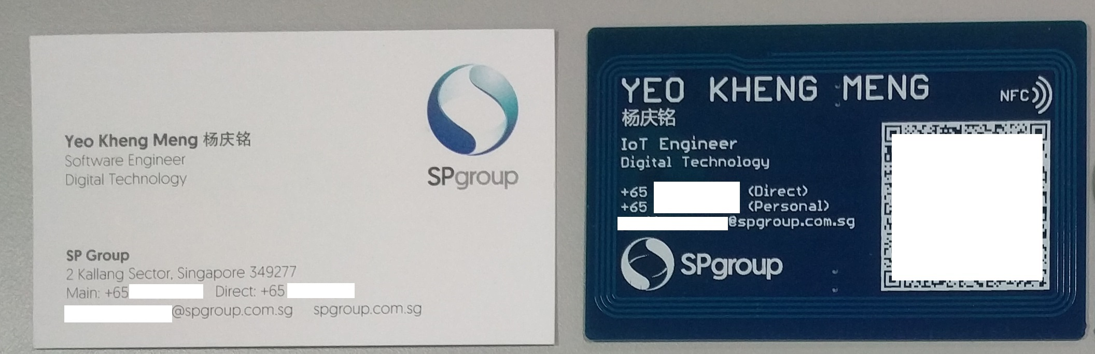
About myself
Volunteer in RK since Mar 2015
2015 NUS Computer Science
IoT Engineer @ SP Digital Technology
RK #2: 8 Mar 2015 @ Blk 425 Jurong West

